Slide 1

Application Security
Chapter 8

Slide 2
Learning Objectives
By the end of this chapter, you should be able to discuss the following:
➢ Why attackers increasingly focus on applications
➢ The main steps in securing applications
➢ Securing WWW service and e-commerce service
➢ Securing email
➢ (In a box) Securing voice over IP (VoIP)
➢ (In a box) The Skype VoIP Service
➢ Securing other user applications
➢ Securing TCP/IP supervisory applications

Slide 3


8-1: Application Security Threats
Executing Commands with the Privileges of a Compromised Application
If an attacker takes over an application, the attacker can execute commands with the privileges of that application
Many applications run with super user (root) privileges

Slide 4
8-1: Application Security Threats
Buffer Overflow Attacks
From Chapter 7: Vulnerabilities, exploits, fixes (patches, manual work-arounds or upgrades)
Buffers are places where data is stored temporarily
If an attacker sends too much data, a buffer might overflow, overwriting an adjacent section of RAM

Slide 5
8-2: Stack Entry and Buffer Overflow
Notes:
* jill.c:
http://72.32.12.210/archives/win2ksecadvice/2001-q2/att-0043/01-jill.c

Slide 6
Secure Coding
Initialize variables to the default values
Determine the size and the input must be less than the size
Determine the character type
DoB: number, etc
Top 10 Secure Coding Practices
https://www.securecoding.cert.org/confluence/display/seccode/Top+10+Secure+Coding+Practices

Slide 7

8-1: Application Security Threats
Few Operating Systems but Many Applications
Application hardening is more total work than operating system hardening
Understanding the Server’s Role and Threat Environment
If it runs only one or a few services, easy to disallow irrelevant things

Slide 8
8-3: Hardening Applications
Basics
Physical Security
Backup
Harden the Operating System
Etc.
Minimize Applications
Main applications
Subsidiary applications
Be guided by security baselines

Slide 9
8-3: Hardening Applications
Create Secure Application Program Configurations
Use baselines to go beyond default installation configurations for high-value targets
Avoid blank passwords or well-known default passwords
Install Patches for All Applications
Minimize the Permissions of Applications
If an attack compromises an application with low permissions, will not own the computer

Slide 10
8-3: Hardening Applications
Add Application Layer Authentication, Authorizations, and Auditing
More specific to the needs of the application than general operating system logins
Can lead to different permissions for different users
Implement Cryptographic Systems
For communication with users

Slide 11

8-4: Securing Custom Applications
Custom Applications
Written by a firm’s programmers
Not likely to be well trained in secure coding
The Key Principle
Never trust user input
Filter user input for inappropriate content

Slide 12
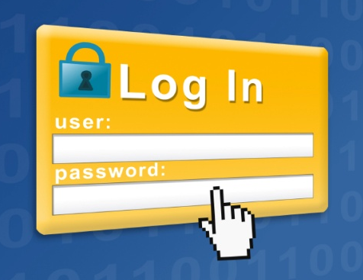
8-4: Securing Custom Applications
Buffer Overflow Attacks
In some languages, specific actions are needed
In other languages, not a major problem
Login Screen Bypass Attacks
Website user gets to a login screen
Instead of logging in, enters a URL for a page that should only be accessible to authorized users

Slide 13
Cross-Site Scripting (XSS) Attacks
Technique: Inject JavaScript, VBScript, ActiveX, HTML, or Flash for execution on a victim’s system
Server application risks
Users unknowingly execute malicious scripts when viewing dynamically generated pages based on content provided by an attacker
An attacker takes over the user session before the user's session cookie expires
An attacker connects users to a malicious server of the attacker's choice
An attacker who can convince a user to access a URL supplied by the attacker could cause script or HTML of the attacker's choice to be executed in the user's browser. An attacker can take actions with the privileges of the user who accessed the URL (e.g., issuing queries on the underlying SQL databases, exploiting the known faulty implementations on the target system)
* Source: http://www.ibm.com

Slide 14
Scripting via a Malicious Link (1)
The attacker sends an e-mail containing the malicious link scripting.
<A HREF= http://legitimateSite.com/registration.cgi?clientprofile=<SCRIPT>malicious code</SCRIPT>>Click here</A>
A victim clicks on the link, the URL is sent to legitimateSite.com including the malicious code. When the server sends a page back to the user including the value of clientprofile, the malicious code will be executed on the client Web browser (see the next page)
* Source: http://www.ibm.com

Slide 15
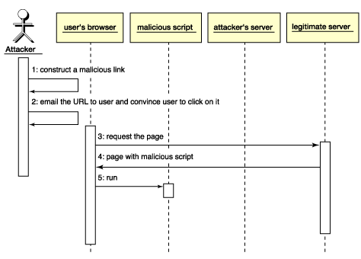
Scripting via a Malicious Link (2)
* Source: http://www.ibm.com

Slide 16
Stealing Users' Cookies (1)
If a webpage uses cookies, these can be stolen
The attacker files a page with malicious script to the part of the site that is vulnerable
When the page is displayed, the malicious script runs, collects the users' cookies, and sends a request to the attacker's Web site with the cookies gathered
The attacker can gain sensitive data such as passwords, credit card numbers, and any arbitrary information the user inputs
* Source: http://www.ibm.com

Slide 17
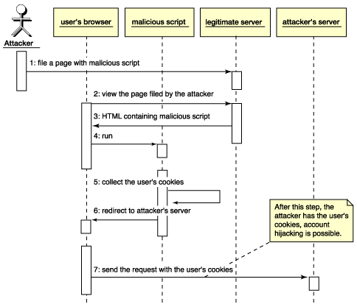
Stealing Users' Cookies (2)
* Source: http://www.ibm.com

Slide 18
8-4: Securing Custom Applications
Cross-Site Scripting (XSS) Attacks
One user’s input can go to another user’s webpage
Usually caused if a website sends back information sent to it without checking for data type, scripts, etc.
Example, If you type your username, it may include something like, “Hello username” in the webpage it sends you

Slide 19
8-4: Securing Custom Applications
Example
Attacker sends the intended victim an e-mail message with a link to a legitimate site
However, the link includes a script that is not visible in the browser window because it is beyond the end of the window
The intended victim clicks on the link and is taken to the legitimate webpage
The URL’s script is sent to the webserver with the HTTP GET command to retrieve the legitimate webpage

Slide 20
8-4: Securing Custom Applications
Example
The webserver sends back a webpage including the script
The script is invisible to the user (browsers do not display scripts)
But the script executes
The script may exploit a vulnerability in the browser or another part of the user’s software

Slide 21
Demo of XSS
Example
http://www.youtube.com/watch?v=r79ozjCL7DA

Slide 22
XSS Defenses
Do not display user input back to users
Sanitize problematic characters
< > “ ‘ # and &
Encode
Convert to HTML entities (&lt; &gt; …)
http://www.dwheeler.com/secure-programs/Secure-Programs-HOWTO/cross-site-malicious-content.html

Slide 23
8-4: Securing Custom Applications
SQL Injection Attacks
SQL commands are injected into data-plane input in order to effect the execution of predefined SQL commands (OWASP)
The exploit:
Read and modify database data
Execute administration operations
Recover the content of a given file
Issue commands to the OS

Slide 24
8-4: Securing Custom Applications
SQL Injection Attacks
Attacker enters an unexpected string
For example: a last name followed by a full SQL query string
The program may execute both the telephone number lookup command and the extra SQL query
This may look up information that should not be available to the attacker
It may even delete an entire table

Slide 25
Demo: SQL Injection Attacks
Example
http://www.timmothyboyd.com/cse7330/index.php
Read
“SQL Injection.ppt” posted
Notes:
'OR 'a'='a

Slide 26
SQL Injection Defenses
Input validation
Do not allow special characters (‘ ; : “)
SQL commands
Use stored procedures
Length limits on user input
No display of SQL errors to end users

Slide 27
8-4: Securing Custom Applications
Must Require Strong Secure Programming Training
General principles
Programming-language-specific information
Application-specific threats and countermeasures
Writing secure PHP applications
Writing secure PHP applications
Top Ten Security Vulnerabilities in PHP Code

Slide 28
8-5: WWW and E-Commerce
Importance of WWW Service and E-Commerce Security
Cost of disruptions, harm to reputation, and market capitalization
Customer fraud
Exposure of sensitive private information

Slide 29
8-5: WWW and E-Commerce
Webservice versus E-Commerce Service
WWW service provides basic user interactions
Microsoft Internet Information Server (IIS), Apache on UNIX, other webserver programs
Webserver market share
E-commerce servers add functionality: Order entry, shopping cart, payment, etc.
Links to internal corporate databases and external services (such as credit card checking)
Custom programs written for special purposes
Notes:
* Code Red worm:
http://en.wikipedia.org/wiki/Code_Red_worm
* Webserver market share:
http://news.netcraft.com/archives/2011/01/12/january-2011-web-server-survey-4.html

Slide 30
8-6: WWW service Versus E-Commerce Service

Slide 31
8-7: Webserver Attacks
Website Defacement
Numerous IIS buffer overflow attacks
Many of which take over the computer
IIS directory traversal attacks

Slide 32
8-8: Directory Traversal Attack
Users should only be able to reach files below the WWW root, which is below the true system root

Slide 33
8-8: Directory Traversal Attack
In URLs, .. means
move up one level.
If allowed, user can
get outside the WWW root box, into other directories

Slide 34
8-7: Webserver Attacks
IIS directory traversal attacks (Figure 8-8)
Companies filter out “..”
Attackers respond with hexadecimal and UNICODE representations for “..” and “..”
Typical of the constant “arms race” between attackers and defenders

Slide 35
8-9: Webserver and E-Commerce Protections
Patching the WWW and E-Commerce Software and Their Components
Patching the webserver software is not enough
Also must patch e-commerce software
E-commerce software might use third-party component software that must be patched
Notes:
* PHP:
http://rochakchauhan.com/blog/2008/07/13/top-ten-security-vulnerabilities-in-php-code/

Slide 36
8-9: Webserver and E-Commerce Protections
Other Website Protections
Reading website error logs
Placing a webserver-specific application proxy server in front of the webserver
Pen Testing WWW Apps
Web application vulnerability assessment: Paros Proxy, WebScarab
Firefox Add-ons: Add N Edit Cookies, Tamper Data
Penetration Testing of Web Applications: libwhisker, nikto

Slide 37
HTTP Status Codes
1xx Informational
2xx Success
200 OK
3xx Redirection
4xx Client Error
403 Forbidden (Access to protected area)
404 File Not Found
5xx Server Error
500 Server Error
Notes:
http://www.theegglestongroup.com/writing/html_error_codes.php

Slide 38
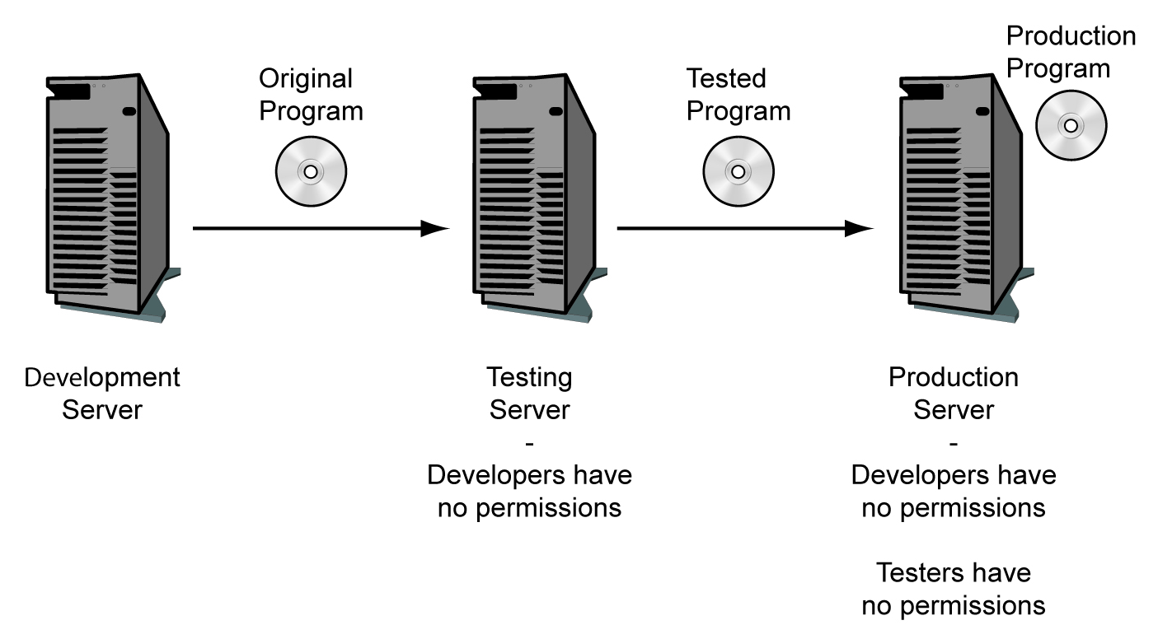
8-10: Staging Servers

Slide 39

8-11: Browser Attacks and Protections
PCs Are Major Targets
Have interesting information and can be attacked through the browser
Client-Side Scripting (Mobile Code)
Java applets: Small Java programs
Usually run in a “sandbox” that limits their access to most of the system
Active-X from Microsoft; highly dangerous because it can do almost everything

Slide 40
8-11: Browser Attacks and Protections
Client-Side Scripting (Mobile Code)
Scripting languages (not full programming languages)
A script is a series of commands in a scripting language
JavaScript (not scripted form of Java)
VBScript (Visual Basic scripting from Microsoft)
A script usually is invisible to users

Slide 41
8-11: Browser Attacks and Protections
You like beef?
click here.
Malicious Links
User usually must click on them to execute (but not always)
Tricking users to visit attacker websites
Social engineering to persuade the victim to click on a link
Choose domain names that are common misspellings of popular domain names
http://www.micosoft.com

Slide 42
8-11: Browser Attacks and Protections
Other Client-Side Attacks
File reading: turn the computer into an unintended file server
Executing a single command
The single command may open a command shell on the user’s computer
The attacker can now enter many commands
C:>

Slide 43
8-11: Browser Attacks and Protections
Other Client-Side Attacks
Automatic redirection to unwanted webpage
On compromised systems, the user may be automatically directed to a specific malicious website if they later make any typing error

Slide 44
8-11: Browser Attacks and Protections
Other Client-Side Attacks
Cookies
Cookies are placed on user computer; can be retrieved by website
Can be used to track users at a website
Can contain private information
Accepting cookies is necessary to use many websites
Notes:
* WSJ:
http://online.wsj.com/article/SB10001424052748703940904575395073512989404.html

Slide 45
8-11: Browser Attacks and Protections
Enhancing Browser Security
Patches and updates
Set strong security configuration options (Figure 8-12) for Microsoft Internet Explorer
Set strong privacy configuration options (Figure 8-13) for Microsoft Internet Explorer

Slide 46
8-12: Internet Options Dialog Box in Internet Explorer

Slide 47
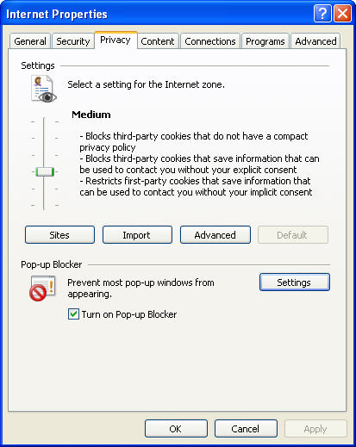
8-13: Internet Explorer Privacy Tab
Copyright Pearson Prentice-Hall 2009

Slide 48
8-14: E-Mail Security
Content Filtering
Malicious code in attachments and HTML bodies (scripts)
Spam: Unsolicited commercial e-mail
Volume is growing rapidly: Slowing PCs and annoying users (porno and fraud)
Filtering for spam also rejects some legitimate messages
Image spam

Slide 49
8-14: E-Mail Security
Inappropriate Content
Companies often filter for sexually or racially harassing messages
Could be sued for not doing so
Extrusion Prevention for Intellectual Property (IP)
Stopping the Transmission of Sensitive Personally Identifiable Information (PII)

Slide 50
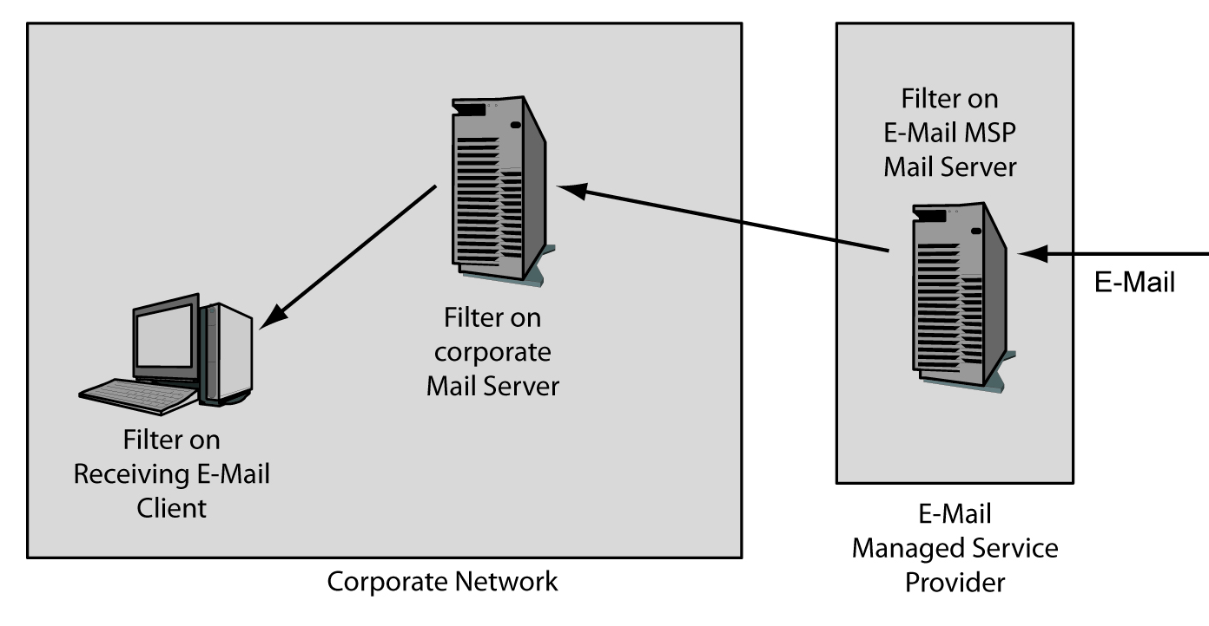
8-15: Possible E-Mail Filtering Locations

Slide 51
8-16: E-Mail Retention
Benefits of Retention
Major part of corporate memory
Often need to retrieve old mail for current purposes
Dangers of Retention
Legal discovery process
Defendant must supply relevant e-mails
Potentially very damaging information
Always expensive
Even if very expensive to retrieve, firms must pay whatever is necessary to do so

Slide 52
8-16: E-Mail Retention
Accidental Retention
Even if firms delete e-mail from mail servers,
May be stored on backup tapes
Users will often store copies on their own computers

Slide 53
8-16: E-Mail Retention
Legal Archiving Requirements
Many laws require retention
Securities and Exchange Commission
Many labor laws
Involuntary terminations
Public information about job openings
Medical problem complaints that may relate to toxic chemicals
Laws vary in duration of storage requirements
Fines or summary judgments if fail to retain and produce required e-mails

Slide 54
8-16: E-Mail Retention
U.S. Federal Rules of Civil Procedure
Specify rules for all U.S. federal civil trials
Specifically address electronically stored information
Initial discovery meeting
Defendant must be able to specify what information is available
Comes shortly after a civil lawsuit begins
Unless carefully thought through before hand, will fail

Slide 55
8-16: E-Mail Retention
U.S. Federal Rules of Civil Procedure
Holds on destruction
Must be put in place if it is foreseeable that a lawsuit will soon begin
Must have strong hold procedures to place holds on all electronically stored information
Archiving Policies and Processes
Must have them
Must reflect a firm’s legal environment
Must be drawn up with the firm’s legal department

Slide 56
8-16: E-Mail Retention
Message Authentication
Spoofed messages can frame employees or the firm itself
Need message authentication to prevent spoofed sender addresses

Slide 57
8-14: E-Mail Security
Employee training
E-mail is not private; company has right to read
Your messages may be forwarded without permission
Never put anything in a message the sender would not want to see in court, printed in the newspapers, or read by his or her boss
Never forward messages without permission

Slide 58
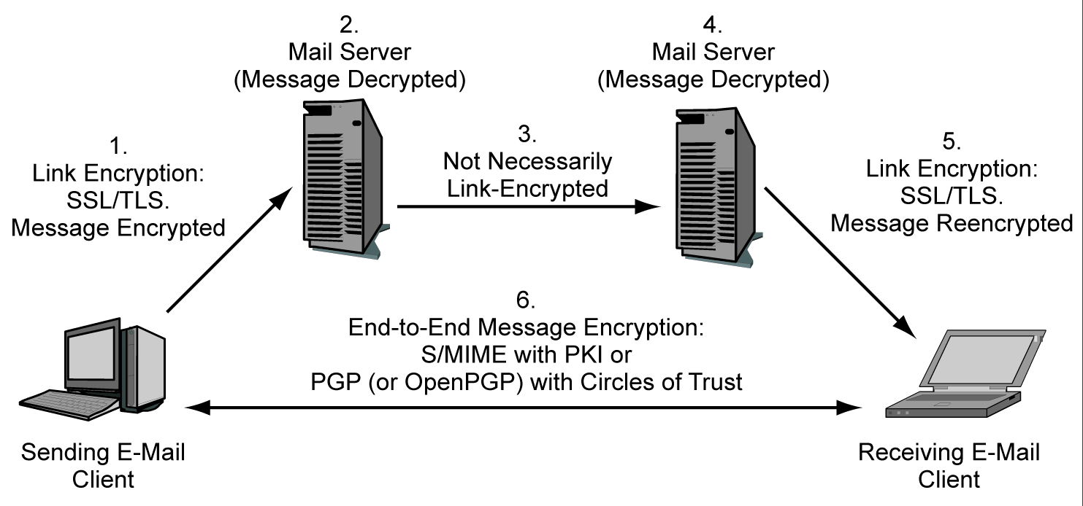
8-14: E-Mail Security
E-Mail Encryption (Figure 8-17)

Slide 59
Signing & Encrypting Emails
Free Secure Email Certificates
http://www.instantssl.com/ssl-certificate-products/free-email-certificate.html
Setting Up Outlook 2010 to Use Signing and Encryption Certificates
http://www.utexas.edu/its/help/digital-certificates/1512
http://www.mcs.csueastbay.edu/~lertaul/CS6525LABassignmnet1.htm
Using S/MIME in Microsoft Outlook (posted on Blackboard)

Slide 60
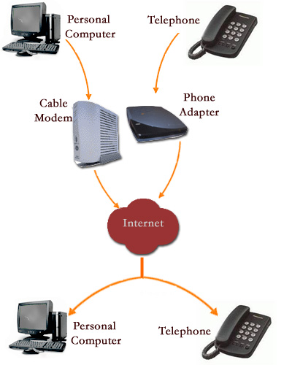
Voice over IP (VoIP)
LAN VoIP, WAN VoIP
Codec: convert your voice into a stream of digital bytes
Each packet: IP header + UDP header + RTP header
Uses UDP
Session Initiation Protocol (SIP)
Real Time Protocol (RTP)

Slide 61

Advantages, Disadvantages of VoIP
Advantages
Low cost
Convergence of voice and data
Increased flexibility
Location independence
Disadvantages
Quality assurance challenges
Emergency calls
Complexity of protocols and implementation
Reliability and network availability challenges
Security risks

Slide 62
8-19: Transport versus Signaling
Concept | Meaning
Signaling (H.323, SIP) | Communication to manage the network. Call setup Call teardown Accounting Etc.
Transport (RTP) | The carriage of voice between the two parties

Slide 63
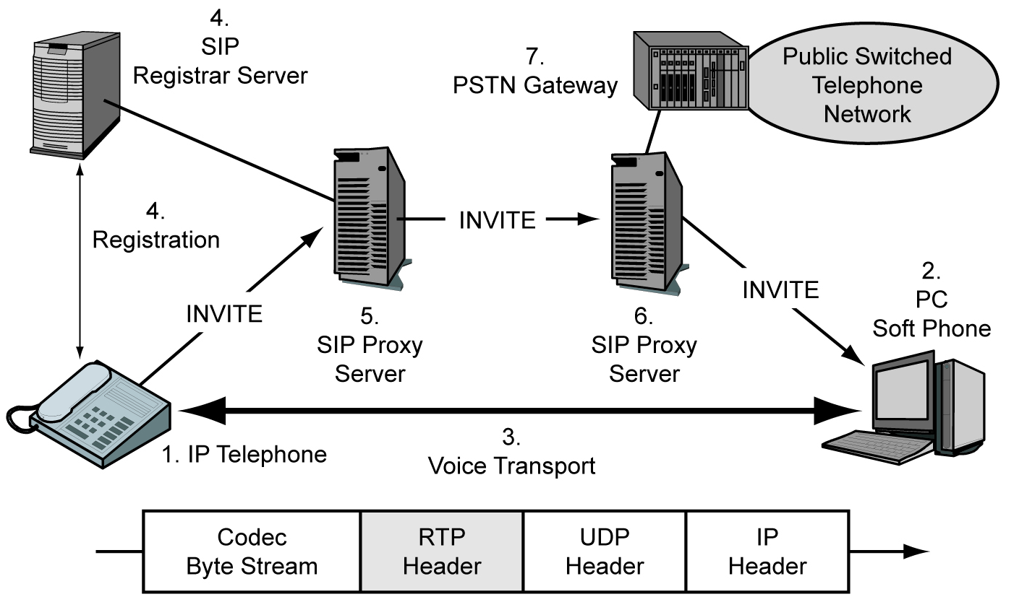
8-18: Voice over IP (VoIP)

Slide 64
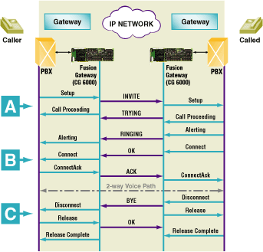
SIP Call Flow
* Source: nmscommunications.com
Notes:
* http://www.nmscommunications.com/DevPlatforms/CaseStudies/UsingSIPforVoIPCallControl.htm
Figure 1 illustrates the steps involved in setting up and terminating a call using SIP. With time progressing down the page, it illustrates a call placed over an IP network between two telephones on the PSTN. The initiation of a call from the PSTN side (Area A in Figure 1) drives the start of the SIP call. On the "caller" side, the stack issues an INVITE message to initiate a call to the "called" end. The INVITE message comprises the basic call set-up information, such as the called and caller addresses, proxy information, and vocoder details to negotiate a common media vocoder format between the two sides. The called end responds with a SIP TRYING message to acknowledge the call request. Signaling then proceeds on the called side to set up the call and generate ring.
When ringing is successful, a RINGING message is returned to the caller side, where the appropriate ringback can be generated to the caller (Area B in Figure 1). When the called side goes off hook, a connect is performed on this side, enabling the media stream. The SIP stack generates an OK message to indicate this state change. In response, the caller side connects the call and acknowledges the connect with an ACK message. A two-way voice and/or video connection is now established.
The call continues without any SIP message exchange until the called side hangs up, which results in the SIP stack generating a BYE message (Area C in Figure 1). The caller side proceeds with the disconnect on its side and acknowledges the call termination with an OK message. Refer to RFC 3261 for details about the content and format of these messages.

Slide 65
VoIP & Wireshark
voip-extension.pcap
voip-extension2downata.pcap

Slide 66
8-20: VoIP Threats
Eavesdropping
Denial-of-Service Attacks
Even small increases in latency and jitter can be highly disruptive
Caller Impersonation
Useful in social engineering
Attacker can appear to be the president based on a falsified source address

Slide 67
8-20: VoIP Threats
Hacking and Malware Attacks
Compromised clients can send attacks
Compromised servers can do disruptive signaling
Toll Fraud
Attacker uses corporate VoIP network to place free calls
Spam over IP Telephony (SPIT)
Especially disruptive because it interrupts the called party in real time

Slide 68
8-21: Implementing VoIP Security
Basic Corporate Security Must Be Strong
Authentication
SIP Identity (RFC 4474) provides strong authentication assurance between second-level domains
Encryption for Confidentiality
Can add to latency

Slide 69
8-21: Implementing VoIP Security
Firewalls
Many short packets
Firewall must prioritize VoIP traffic
Must handle ports for signaling
SIP uses Port 5060
H.323 uses Ports 1719 and 1720
Must create an exception for each conversation, which is assigned a specific port
Must close the transport port immediately after conversation ends

Slide 70
8-21: Implementing VoIP Security
NAT Problems
NAT firewall must handle VoIP NAT traversal
NAT adds a small amount of latency
Separation: Anticonvergence
The convergence goal for data and voice
Virtual LANs (VLANs)
Separate voice and data traffic on different VLANs
Separate VoIP servers from VoIP phones on different VLANs

Slide 71
8-22: Skype Security Concerns
Widely Used Public VoIP Service
Uses Proprietary Protocols and Code
Vulnerabilities? Backdoors? Etc.
Firewalls have a difficult time even recognizing Skype traffic
Encryption for Confidentiality
Skype reportedly uses strong security
However, Skype keep encryption keys, allowing it to do eavesdropping

Slide 72
8-22: Skype Security Concerns
Inadequate Authentication
Uncontrolled user registration; can use someone else’s name and so appear to be them
Peer-to-Peer (P2P) Service
Uses this architecture and its proprietary (and rapidly changing) protocol to get through corporate firewalls
Bad for corporate security control
Skype File Sharing
Does not work with antivirus programs

Slide 73
8-23: Other Applications
Databases
Often used in mission-critical applications
Relational databases: Tables with rows (entities) and columns (attributes)
As discussed earlier, avoid SQL injection attacks

Slide 74
8-23: Other Applications
Databases
Restrict Access to Data
Restrict users to certain columns (attributes) in each row
For instance, deny access to salary column to most users
Limit access control to rows
For instance, only rows containing data about people in the user’s own department

Slide 75
8-23: Other Applications
Databases
Restrict Granularity
Prevent access to individual data
Allow trend analysts to deal only with sums and averages for aggregates such as departments

Slide 76
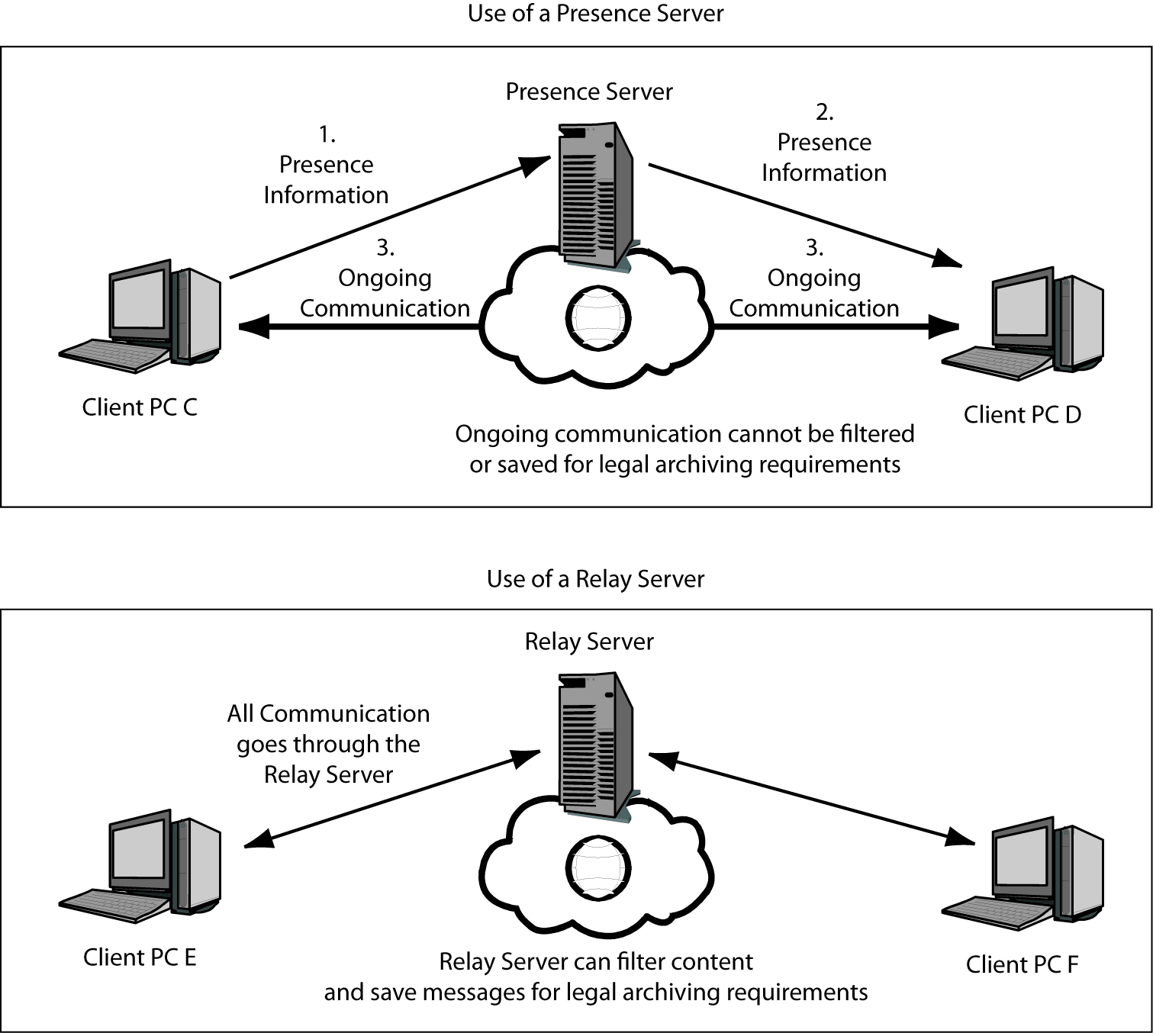
8-24: Servers in Instant Messaging (IM)
Presence servers merely tell the clients that others exist and what their IP addresses are

Slide 77
8-24: Servers in Instant Messaging (IM)
All transmissions go through relay servers when relay servers are used.

Slide 78
8-23: Other Applications
Spreadsheet Security
Spreadsheets are widely used and the subject of many compliance regulations
Need for security testing
Spreadsheet vault server to implement controls (Figure 8-25)

Slide 79
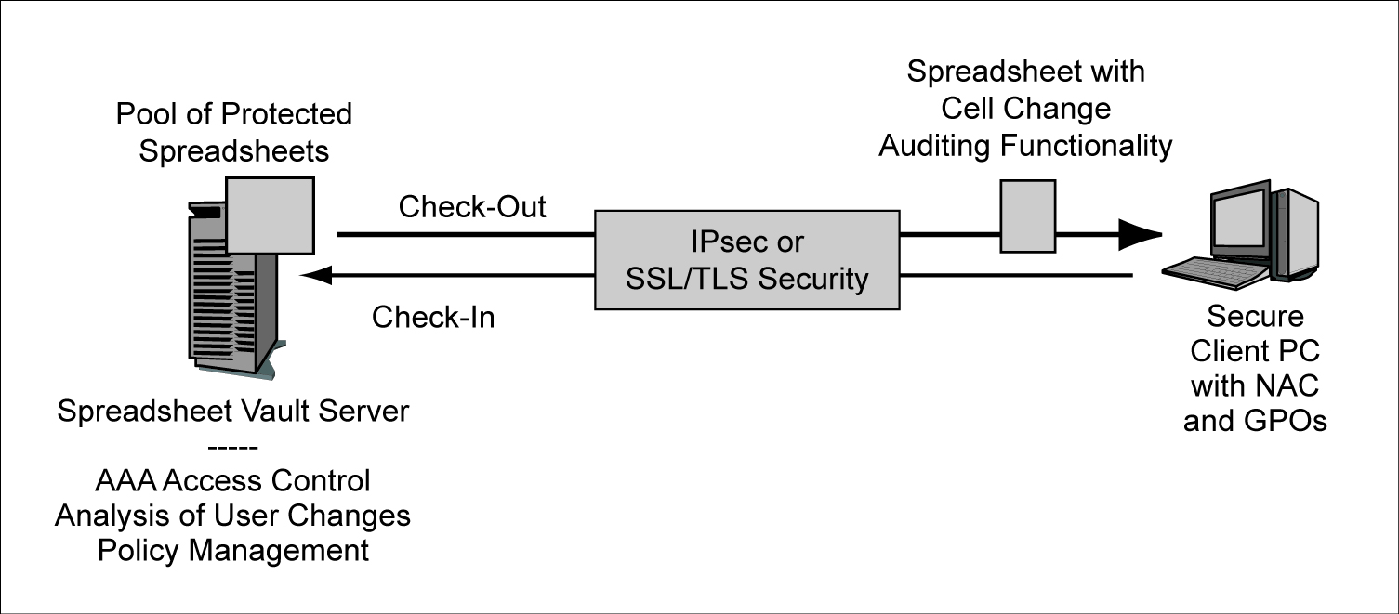
8-25: Spreadsheet Vault Server
2.
Spreadsheets record each change for auditing purposes
1.
The vault server stores spreadsheets and strongly controls access to them.
Authentication
Authorizations
Auditing

Slide 80
8-25: Spreadsheet Vault Server
3.
Cryptographic Protections for Transmissions
4.
Strong Client Security

Slide 81
8-26: TCP/IP Supervisory Applications
TCP/IP Supervisory Protocols
Many supervisory protocols in TCP/IP
ARP, ICMP, DNS, DHCP, LDAP, RIP, OSPF, BGP, SNMP, etc.
The targets of many attacks
The IETF has a program to improve security in all (the Danvers Doctrine)

Slide 82
8-26: TCP/IP Supervisory Applications
Example
Simple Network Management Protocol (SNMP)
Messages
GET messages to get information from a managed object
SET messages to change the configuration of a managed object
SET is often turned off because it is dangerous

Slide 83
8-26: TCP/IP Supervisory Applications
Example
SNMP versions and security
Version 1: No security
Version 2: Weak authentication with a community string shared by the manager and managed devices
Version 3: Pair-shared secrets, optional confidentiality, message integrity, and anti-replay protection
Still needed: public key authentication

Slide 84
8-26: TCP/IP Supervisory Applications
IT Security People Must Work with the Networking Staff
To ensure that appropriate security is being applied to supervisory protocols
Not a traditional area for IT security in most firms

Slide 85
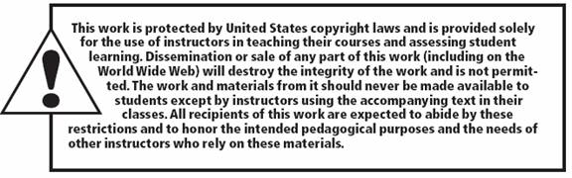
All rights reserved. No part of this publication may be reproduced, stored in a retrieval system, or transmitted, in any form or by any means, electronic, mechanical, photocopying, recording, or otherwise, without the prior written permission of the publisher. Printed in the United States of America.
Copyright © 2010 Pearson Education, Inc.
Publishing as Prentice Hall

